Slide 1
Submission to Molecular Nutrition and Food Research
Abstract: 200 words (currently 270)
Total: 5,000 words, 7 pages max (free) including references as well as figure and table legends
Figures: TIFF, 800-1,200 DPI (how many?)
Figure legends: separate Word file

Slide 2

Experiment 1:
Group1: Nrf2-/-, AIN93M (N=9)
Group2: Nrf2-/-, PEITC (N=9)
Experiment 2:
Group3: WT, AIN93M (N=5)
Group4: WT, PEITC (N=5)
Experiment 3:
Group5: WT, AIN93M (N=3)
Group6: WT, AIN93M, DSS (N=3)
Group7: WT, Cranberry, DSS (N=3)
Group8: WT, PEITC, DSS (N=3)
Group9: Nrf2-/-, AIN93M (N=3)
Group10: Nrf2-/-, AIN93M, DSS (N=3)
Group11: Nrf2-/-, Cranberry, DSS (N=3)
Group12: Nrf2-/-, PEITC, DSS (N=3)
AIN93M : Groups 1, 3, 5, 6, 9 and 10
AIN93M: Groups 2, 4,
7, 8, 11 and 12
AIN93M + 0.05% PEITC Groups 2, 4,8 and 12
AIN93M + Cranberry: Groups 7 and 11
X
X
X
X
X
X
Week 0 1 2 4 5 6 8
Gut microbiota equalization period (2 weeks)
Notes:
Figure 1: experimental design. Mice fecal samples for the 16S sequencing were collected individually at 3 timepoints – at the end of the 2-week equalization period (Week 0), at an early timepoint (Week 1) and at a late timepoint (Week 4 or Week 8). Samples used for metabolite analysis were collected at an early and a late timepoints (Weeks 2 and Week 6 respectively).

Slide 3
Forward Primer | Reverse Primer
515F (Parada) | 806R (Apprill)
GTGYCAGCMGCCGCGGTAA | GGACTACNVGGGTWTCTAAT
Table 1: V4 primer sequence used for 16s RNA sequencing library preparation

Slide 4
Figure 2: 16S sequencing depth

Slide 5
Figure 2: 16S sequencing depth (2/22/2023)

Slide 6
Table 1: OTUs mapping to Kingdoms. Number of OTU (% total)
Kingdom | Experiment 1: Nrf2 KO Mice | Experiment 2: WT Mice | Experiment 3: WT and Nrf2 KO | Combined
Bacteria | 10,197 (94.78%) | 7,994 (98.34%) | 7,558 (96.07%) | 22,251 (95.73%)
Eukaryota | 472 (4.39%) | 116 (1.43%) | 232 (2.95%) | 812 (3.49%)
Archaea | 4 (0.04%) | 0 (0%) | 2 (0.03%) | 6 (0.03%)
Unknown | 86 (0.80%) | 19 (0.23%) | 75 (0.95%) | 175 (0.75%)

Slide 7
Figure 3: Shannon’s index (Alpha Diversity)

Slide 8
Figure 3: Shannon’s index (Alpha Diversity)

Slide 9
Figure4: Bacteroidetes vs. Firmicutes. Experiments 1 and 2 (left), and 3 (right).

Slide 10
Bacteroidetes/Firmicutes Analysis
Wile Type
Nrf2 KO
Term | Estimate | 95% C.I.L.L. | 95% C.I.U.L. | p-Value | Sign
Week 0 | 1.634 | 1.31 | 2.039 | <0.001 | **
Week 1 | 0.969 | 0.777 | 1.209 | 0.774
Week 4 | 1.009 | 0.809 | 1.259 | 0.933
PEITC/AIN93M | 0.998 | 0.73 | 1.365 | 0.992
Week 1:PEITC/Week0:AIN93M | 0.989 | 0.635 | 1.54 | 0.96
Week 4:PEITC/Week0:AIN93M | 1.089 | 0.7 | 1.696 | 0.694
Term | Estimate | 95% C.I.L.L. | 95% C.I.U.L. | p-Value | Sign
Week 0 | 2.097 | 1.467 | 2.995 | <0.001 | **
Week 1 | 1.891 | 1.539 | 2.324 | <0.001 | **
Week 4 | 1.393 | 1.134 | 1.712 | 0.002 | **
PEITC /AIN93M | 1.036 | 0.774 | 1.386 | 0.809
Week 1:DietPEITC/Week0:AIN93M | 0.757 | 0.501 | 1.143 | 0.179
Means and SEM of Bacteroidetes/Firmicutes Ratios
Genotype | Diet | Week 0 | Week 1 | Week 4
Wild Type | AIN93M | 1.66(0.15) | 0.97(0.04) | 1.04(0.12)
Wild Type | PEITC | 1.72(0.26) | 0.98(0.1) | 1.11(0.09)
Nrf2 KO | AIN93M |  | 2.02(0.27) | 1.43(0.12)
Nrf2 KO | PEITC |  | 1.52(0.11) | 1.51(0.15)
Nrf2 KO | Pooled | 2.15(0.35)

Slide 11
Figure4: PCA at Phylum level. Experiments 1 and 2 (left), and 3 (right).

Slide 12
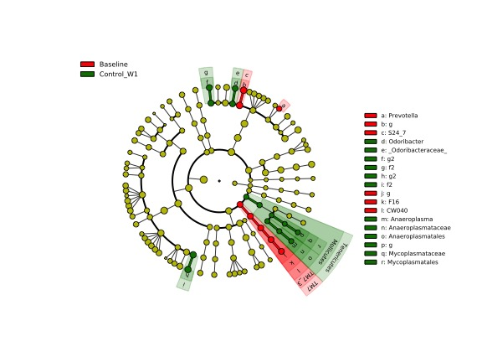
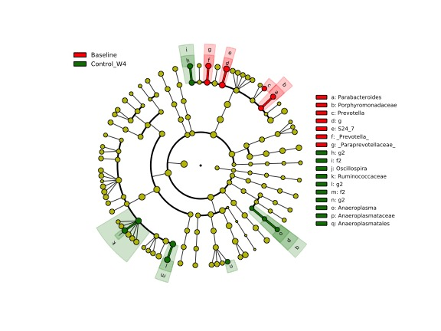
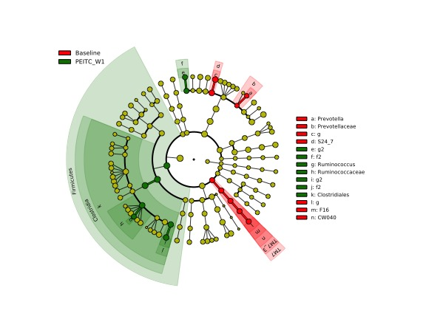
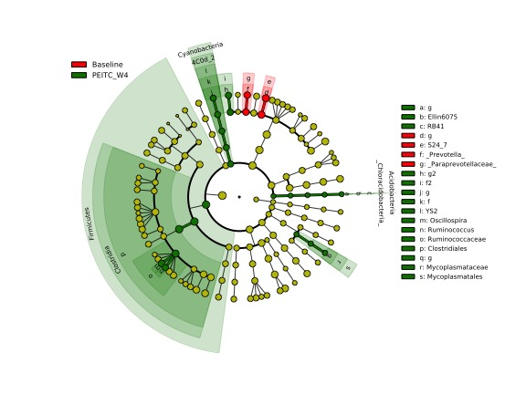
Figure 5:
A
B
C
D

Slide 13
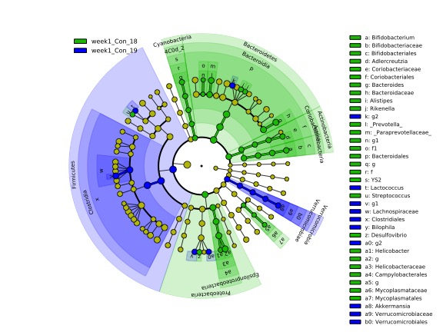
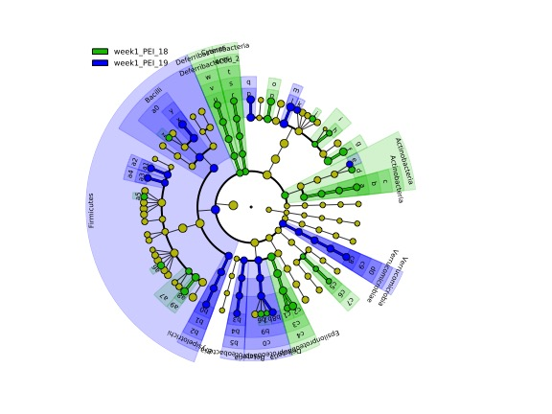
Figure 6
A
B

Slide 14
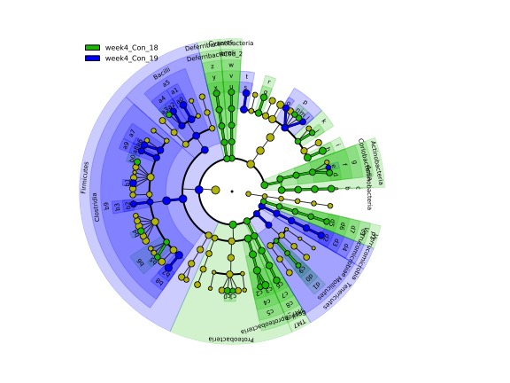
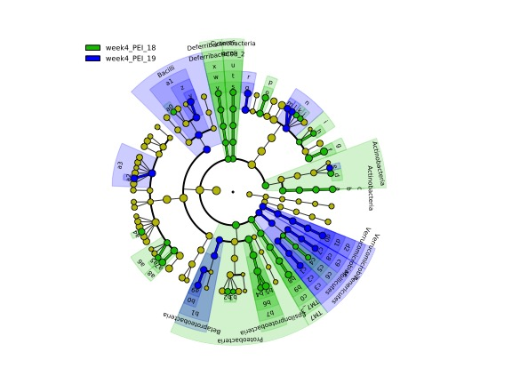
Figure 7
A
B

Slide 15
Figure 8: Aminoacids (Experiment 3 only)

Slide 16
4A
4B

Slide 17
C
Figure 4: Biplots of bacterial metabolites. The points represent individual samples are color-coded by treatment and diet or by genotype. The arrows show the direction of the increased amount and relative magnitude of the effect of each microbial metabolite. (a) Biplot of amino acids color-coded by treatment and diet; (b) biplot of bile acids color-coded by genotype; (c) biplot of SFA color-coded by treatment; (b) biplot of SFA color-coded by genotype.

Slide 18
Figure 5: Biplots of bacterial metabolites. The points represent individual samples are color-coded by treatment and diet (a) or by genotype (b). The arrows show the direction of the increased amount and relative magnitude of the effect of each microbial metabolite and color-coded by the type of metabolite.

Slide 19
Table 3: multinomial regression predictions of treatment groups by microbial metabolite PCA

Slide 20
Table 4: multinomial regression predictions of genotype by microbial metabolite PCA

Slide 21
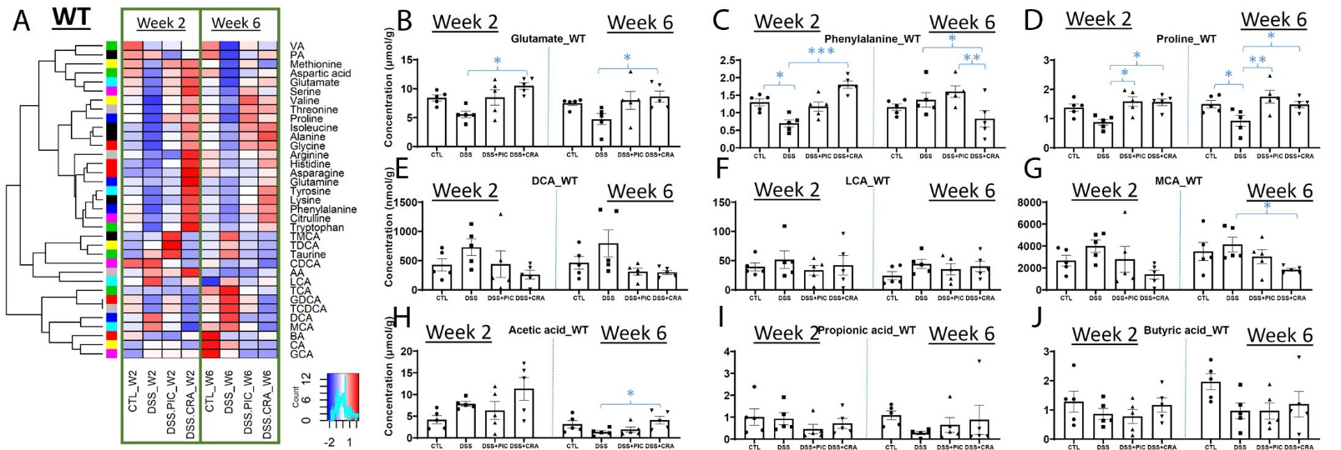
Fig. 6. Effects of DSS, PEITC and cranberry cotreatments on fecal metabolome of WT mice. Fecal samples collected at week 2 and 6 of 4 treatments, including control (CTL), DSS, DSS+PEITC (DSS+PIC), and DSS+cranberry (DSS+CRA), were analyzed by 4 LC-MS methods (143). The concentrations of amino acids, bile acids, and SCFA were quantified. (A) A heatmap on the distribution of amino acids, bile acids and SCFA in fecal samples from 4 treatments. (B-D) Concentrations of major amino acids, including glutamate, phenylalanine, and proline. (E-G) Concentrations of major bile acids, including DCA, LCA, and MCA. (H-J) Concentrations of major SCFA, including acetic acid (AA), propionic acid (PA), and butyric acid (BA).

Slide 22
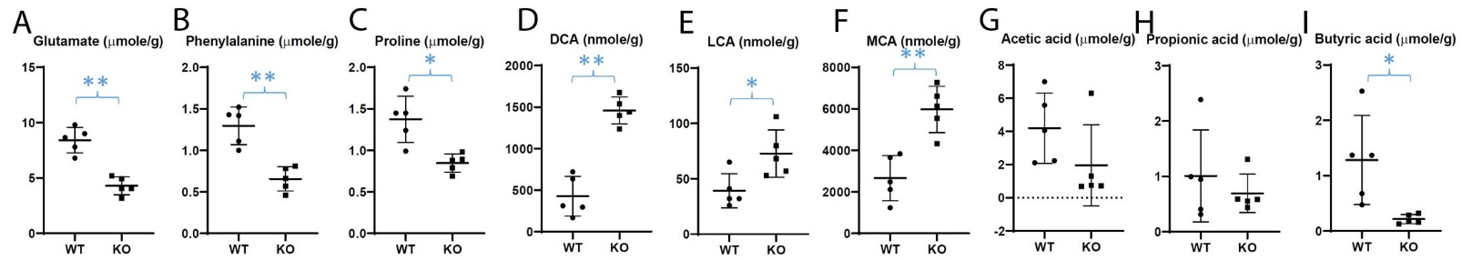
Fig. 7. Differences in fecal metabolite profile between WT and Nrf2-null (KO) mice. The concentrations of amino acids, bile acids, and SCFA were quantified in the fecal samples from untreated WT and KO mice (143). (A-C) Concentrations of glutamate, phenylalanine, and proline. (D-F) Concentrations of major bile acids. (G-I) Concentrations of major SCFA.

Slide 23
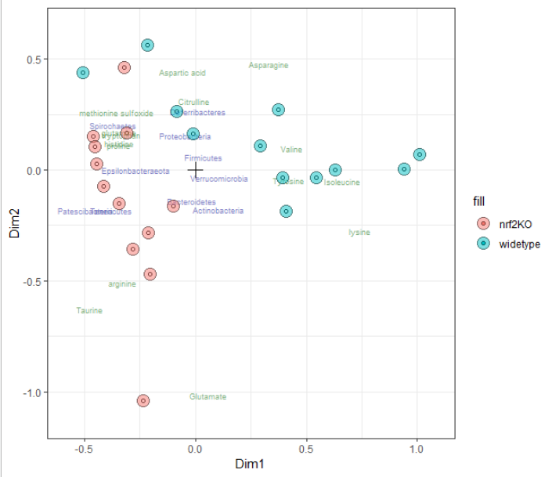
Figure 8: COMBI data integration – microbial counts + aminoacids

Slide 24
Renyi’s comments, 03/27/21
Cranberry diet was not included in the Results section, but it's in the title and included in the figures. Need to include or exclude cranberry for all parts.
The figure labelling is not consistent. timepoint Week_4 in Fig 1 but week_8 in Fig. 4. and labels such Con_PEI_18, con_PEI_19 , are confusing ( I know 18 and 19 refer to the year the experiments were performed, but not relevant here)
The circle figures (Fig 5-7) are hard to understand for average readers.
The 16s sequencing data, raw and analyzed, may need to be uploaded to NCBI GEO.

